Slide 1
Big Data Frameworks
Ramesh Ragala
VIT Chennai

Slide 2
How MapReduce Works
Anatomy of a MapReduce Job Run:
  MapReduce job can be with a single method call : submit() or waitForCompletion()
  This method call conceals a great deal of processing behind the scenes.
  The steps Hadoop takes to run a job:: At the highest level, there are five independent entities

Slide 3
How MapReduce Works
Anatomy of a MapReduce Job Run:
    1. The client, which submits the MapReduce job
    2. The YARN resource manager, which coordinates the allocation of compute resources on the cluster.
    3. The YARN node managers, which launch and monitor the compute containers on machines in the cluster.
    4. The MapReduce application master, which coordinates the tasks running the MapReduce job. The application master and the MapReduce tasks run in containers that are scheduled by the resource manager and managed by the node managers.
    The distributed filesystem , which is used for sharing job files between the other entities.

Slide 4
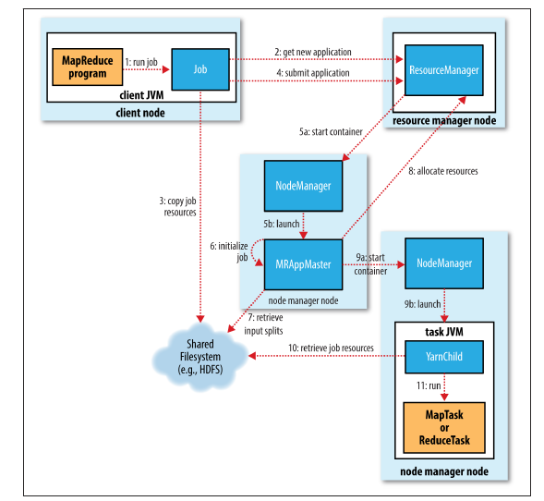
How MapReduce Works

Slide 5
How MapReduce Works
Job Submission
  The submit() method on Job creates an internal JobSubmitter instance and calls submitJobInternal() on it
  Having submitted the job, waitForCompletion() polls the job’s progress once per second and reports the progress to the console if it has changed since the last report.
  Job counters are displayed after job completes its work successfully.
  If job is failed, then it shows the error logs in the console

Slide 6
How MapReduce Works
Job Submission
  The job submission process implemented by JobSubmitter does the following
    Asks the resource manager for a new application ID, used for the MapReduce job ID
    Checks the output specification of the job. For example, if the output directory has not been specified or it already exists, the job is not submitted and an error is thrown to the MapReduce program.
    Computes the input splits for the job. If the splits cannot be computed (because the input paths don’t exist, for example), the job is not submitted and an error is thrown to the MapReduce program.
    Copies the resources needed to run the job, including the job JAR file, the configuration file, and the computed input splits, to the shared filesystem in a directory named after the job ID. The job JAR is copied with a high replication factor (controlled by the mapreduce.client.submit.file.replication property, which defaults to 10) so that there are lots of copies across the cluster for the node managers to access when they run tasks for the job.
    Submits the job by calling submitApplication() on the resource manager

Slide 7
How MapReduce Works
Job Initialization
  When the resource manager receives a call to its submitApplication() method, it hands off the request to the YARN scheduler.
  The scheduler allocates a container, and the resource manager then launches the application master’s process there, under the node manager’s management.
  The application master for MapReduce jobs is a Java application whose main class is MRAppMaster.
  It initializes the job by creating a number of bookkeeping objects to keep track of the job’s progress, as it will receive progress and completion reports from the tasks (step 6).
  Next, it retrieves the input splits computed in the client from the shared filesystem (step 7).
  It then creates a map task object for each split, as well as a number of reduce task objects determined by the mapreduce.job.reduces property (set by the setNumReduceTasks() method on Job).
  Tasks are given IDs at this point.

Slide 8
How MapReduce Works
Job Initialization
  The application master must decide how to run the tasks that make up the MapReduce job.
  If the job is small, the application master may choose to run the tasks in the same JVM as itself.
  This happens when it judges that the overhead of allocating and running tasks in new containers outweighs the gain to be had in running them in parallel, compared to running them sequentially on one node.
  Such a job is said to be uberized, or run as an uber task.
  When we can say the job is small?
  By default, a small job is one that has less than 10 mappers, only one reducer, and an input size that is less than the size of one HDFS block.
  Uber tasks must be enabled explicitly, by setting mapreduce.job.ubertask.enable to true.

Slide 9
How MapReduce Works
Job Initialization
  Finally, before any tasks can be run, the application master calls the setupJob() method on the OutputCommitter.
  For FileOutputCommitter, which is the default, it will create the final output directory for the job and the temporary working space for the task output.

Slide 10
How MapReduce Works
Task Assignment
  If the job does not qualify for running as an uber task, then the application master requests containers for all the map and reduce tasks in the job from the resource manager.
  Requests for map tasks are made first and with a higher priority than those for reduce tasks, since all the map tasks must complete before the sort phase of the reduce can start.
  Reduce tasks can run anywhere in the cluster, but requests for map tasks have data locality constraints that the scheduler tries to honor .
  In the optimal case, the task is data local—that is, running on the same node that the split resides on.
  Alternatively, the task may be rack local: on the same rack, but not
  the same node, as the split.
  Some tasks are neither data local nor rack local and retrieve their data from a different rack than the one they are running on.
  For a particular job run, you can determine the number of tasks that ran at each locality level by looking at the job’s counters

Slide 11
How MapReduce Works
Task Assignment
  Requests also specify memory requirements and CPUs for tasks.
  By default, each map and reduce task is allocated 1,024 MB of memory and one virtual core.
  The values are configurable on a per-job basis (subject to minimum and maximum values via the following properties:
    mapreduce.map.memory.mb,
    mapreduce.reduce.memory.mb
    mapreduce.map.cpu.vcores
    mapreduce.reduce.cpu.vcores

Slide 12
How MapReduce Works
Task Execution
  Once a task has been assigned resources for a container on a particular node by the resource manager’s scheduler, the application master starts the container by contacting the node manager
  The task is executed by a Java application whose main class is YarnChild.
  Before it can run the task, it localizes the resources that the task needs, including the job configuration and JAR file, and any files from the distributed cache .
  Finally, it runs the map or reduce task.
  The YarnChild runs in a dedicated JVM. → so, any bugs in the user-defined map and reduce functions (or even in YarnChild) don’t affect the node manager—by causing it to crash or hang.

Slide 13
How MapReduce Works
Task Execution
  Each task can perform setup and commit actions, which are run in the same JVM as the task itself and are determined by the OutputCommitter for the job.
  For file-based jobs, the commit action moves the task output from a temporary location to its final location.
  The commit protocol ensures that when speculative execution is enabled, only one of the duplicate tasks is committed and the other is aborted.
  Streaming:
    Streaming runs special map and reduce tasks for the purpose of launching the user supplied executable and communicating with it.
    The Streaming task communicates with the process using standard input and output streams.
    During execution of the task, the Java process passes input key-value pairs to the external process, which runs it through the user-defined map or reduce function and passes the output key-value pairs back to the Java process.
    From the node manager’s point of view, it is as if the child process ran the map or reduce code itself.

Slide 14
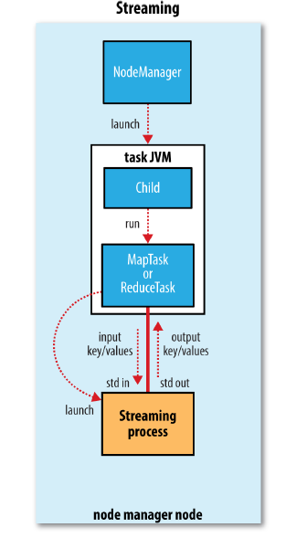
How MapReduce Works
Task Execution
  Streaming

Slide 15
How MapReduce Works
Progress and Status Updates
  MapReduce jobs are long-running batch jobs and takes more time to running jobs
  So user expects a feedback about the job processing.
  A job and tasks have status, which includes such things as the state of the job or task, the progress of the maps and reduces, the values of the job counters and status message.
  The states of the job or tasks are as follows
    Running
    Successfully completed
    Failed
  Even through, these statuses can change over the time, how these changes get communicated back to the client?

Slide 16
How MapReduce Works
Progress and Status Updates
  When task is running, it keeps track of its progress (how much portion of the job is completed).
  For map tasks, this is the proportion of the input that has been processed.
  For reduce tasks, it’s a little more complex, but the system can still estimate the proportion of the reduce input processed.
  It does this by dividing the total progress into three parts, corresponding to the three phases of the shuffle.
  Example:
    For example, if the task has run the reducer on half its input, the task’s progress is 5/6, since it has completed the copy and sort phases (1/3 each) and is halfway through the reduce phase (1/6).
  Tasks also have a set of counters that count various events as the task runs , which are either built into the framework, such as the number of map output records written, or defined by users.

Slide 17
How MapReduce Works
Progress and Status Updates
  As the map or reduce task runs, the child process communicates with its parent application master through the umbilical interface.
  The task reports its progress and status back to its application master, which has an aggregate view of the job, every three seconds over the umbilical interface.
  During the course of the job, the client receives the latest status by polling the application master every second.
  Clients can also use Job’s getStatus() method to obtain a JobStatus instance, which contains all of the status information for the job.

Slide 18
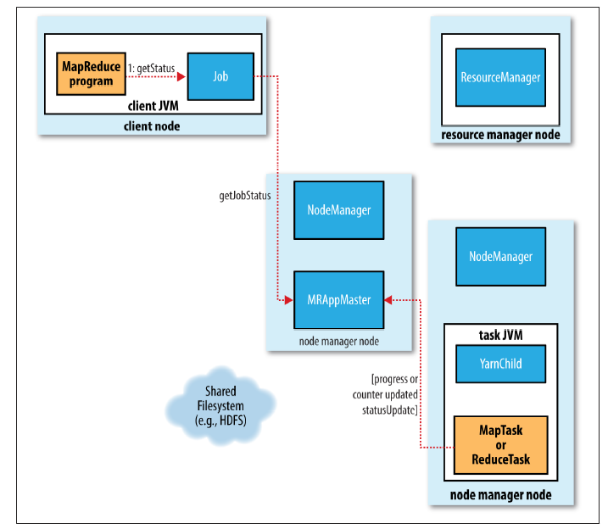
How MapReduce Works
Progress and Status Updates

Slide 19
How MapReduce Works
Job Completion
  When the application master receives a notification that the last task for a job is complete, it changes the status for the job to “successful.”
  Then, when the Job polls for status, it learns that the job has completed successfully, so it prints a message to tell the user and then returns from the waitForCompletion() method.
  Job statistics and counters are printed to the console at this point.
  Finally, on job completion, the application master and the task containers clean up their working state (so intermediate output is deleted), and the OutputCommitter’s commit Job() method is called.
  Job information can be archived by job history server

Slide 20
How MapReduce Works
Failures
  In the real world, user code is buggy, processes crash, and machines fail.
  One of the major benefits of using Hadoop is its ability to handle such failures and allow your job to complete successfully.
  The failure entities in the Hadoop Framework are:
    Task Failures
    Application Master Failures
    Node Manager Failures
    Resource Manager Failures

